Slide 1
Explain Resiliency and Site Security Concepts
CompTIA Security+ Exam SY0-701
Lesson 7

Slide 2
Asset Management
Lesson 7
Topic 7A

Slide 3
Asset Tracking
Assets
  Anything with value!
  Cyber asset tracking is IT centric
Assignment and Ownership
Notes:
We are focusing on technical assets that require some degree of configuration. An organization also has many assets with no configuration requirement, such as furniture and buildings.

Slide 4
Asset Tracking
Asset Tracking and Monitoring
Manual Inventory
Network Scanning
Asset Management Software
Configuration Management Database (CMDB)
Mobile Device Management (MDM)
Cloud Asset Discovery

Slide 5
Asset Protection Concepts
Identify and prioritize assets based on sensitivity and impact
Standard naming convention
Configuration management
Change control and change management
Notes:
Asset management is the first step in developing a cybersecurity program. It's critically important to identify what needs to be protected prior to implementing any controls.

Slide 6
Data Backups
Ensure the availability and integrity of an organization's critical data and systems
Simple backups vs Enterprise Data Protection Strategy
Critical capabilities for enterprise backup solutions typically include:
  Support for various environments (virtual, physical, and cloud)
  Data deduplication and compression to optimize storage space
  Instant recovery and replication for quick failover
  Ransomware protection and encryption for data security
  Granular restore options for individual files, folders, or applications
  Reporting, monitoring, and alerting tools for effective management
  Integration with virtualization platforms, cloud providers, and storage systems
  Encryption to protect copies of sensitive data stored in backup sets
Notes:
Ransomware poses a significant threat to businesses and organizations by encrypting vital data and demanding a ransom for its release. In many cases, ransomware attacks also target backup infrastructure, hindering recovery efforts and further exacerbating the attack's impact. Perpetrators often employ advanced techniques to infiltrate and compromise both primary and backup systems, rendering them useless when needed. Organizations can implement several strategies to defend against this risk, such as maintaining air-gapped backups physically disconnected from the network, thereby actively preventing ransomware from accessing and encrypting them.

Slide 7
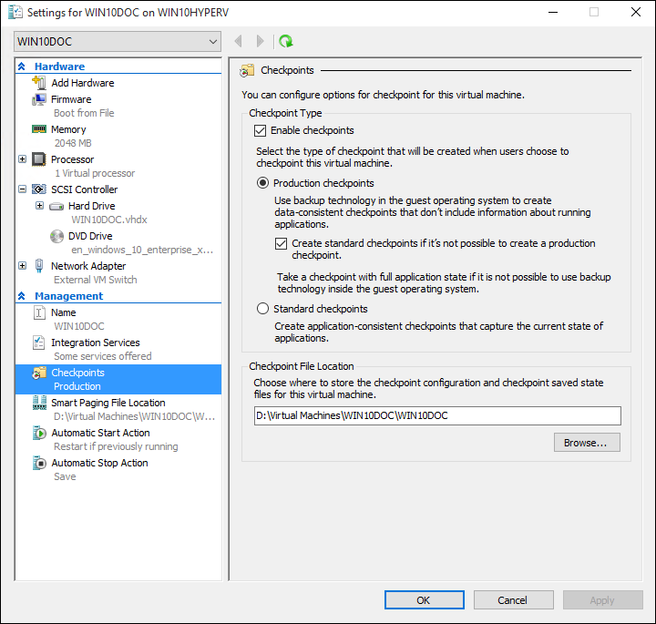
Advanced Data Protection
Snapshots
VM snapshots
Filesystem snapshots
SAN snapshots
The checkpoint configuration section for a Hyper-V virtual machine. Checkpoints refer to Microsoft's implementation of snapshot functionality. (Screenshot used with permission from Microsoft.)
Notes:
Snapshots, replication and journaling are not replacements for backups. A corrupted filesystem leads to complete disaster if standard, offline backups are not available. Even replication can be rendered useless because replication often results in nothing more than two copies of the corrupted filesystem.

Slide 8
Advanced Data Protection
Replication and Journaling
Database mirroring
SAN replication
VM replication

Slide 9
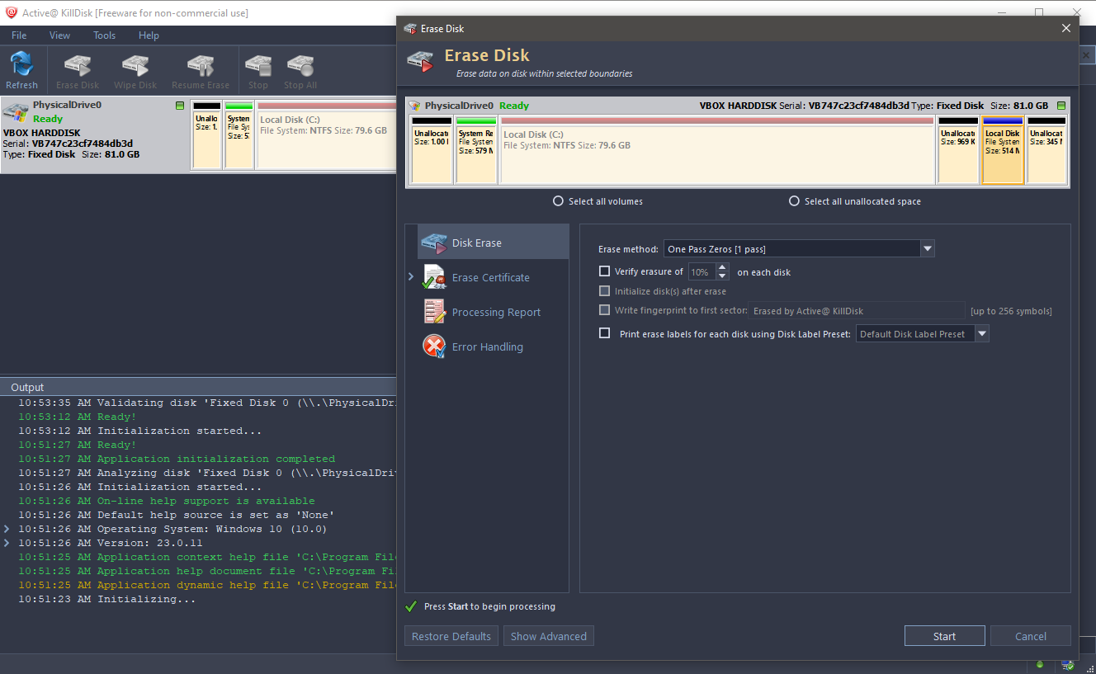
Secure Data Destruction
Asset Disposal
Sanitization
Destruction
Certification
Active KillDisk data wiping software. (Screenshot used with permission from LSoft Technologies, Inc.)

Slide 10
Asset Management
Asset Tracking
Asset Protection Changes
Data Backups
Advanced Data Protection
Secure Data Classification
Notes:
Take some time at the end of each topic to answer questions. You can use the review questions for discussion in class or set them for students to complete individually during or after class.

Slide 11
Applied Lab: Implement Backups
Assisted Lab: Performing Drive Sanitization

Slide 12
Redundancy Strategies
Lesson 7
Topic 7B

Slide 13
Continuity of Operations
Ensuring that an organization can maintain or quickly resume its critical functions in the event of a disruption, disaster, or crisis
Regular testing and updating of continuity of operations plans (COOP) are crucial to ensure the organization can maintain essential functions during and after disruptive events
Backups play a critical role in the continuity of operations plans (COOP) by safeguarding against data loss and restoring systems and data in the event of disruptions
Capacity planning is a critical process in which organizations assess their current and future resource requirements to ensure they can efficiently meet their business objectives

Slide 14
Capacity Planning Risks
People Risks
Cross-Training
Remote Work Plans
Alternative Reporting Structures
Changes in Workforce Capacity
Rapid hiring
Layoffs
Notes:
Technologies and software associated with remote work:
Virtual Private Network (VPN)—Provides secure access to an organization's internal network and resources.
Remote Desktop Software—Allows remote access to computers or virtual desktops in the office or the tools used by the help desk and service-center teams to support employees.
Cloud-Based Tools—Platforms like Microsoft 365, Google Workspace, Dropbox, Slack, and many other popular tools enable remote team collaboration, document sharing, and communication.
Video Conferencing Software—Applications like Zoom, Microsoft Teams, or Webex facilitate virtual meetings, conference calls, and screen sharing.
Instant Messaging and Chat Tools—Applications like Slack, Microsoft Teams, or Discord enable real-time communication and quick collaboration.
Virtual Phone Systems—Cloud-based phone systems allow employees to make and receive calls remotely using their computers or mobile devices.
Project Management Tools—Platforms like Trello, Asana, or Jira assist in task management, project tracking, and team coordination.

Slide 15
High Availability
High Availability
Scalability and Elasticity
Fault Tolerance and Redundancy
Site-level Resiliency
  Hot
  Warm
  Cold
  Cloud

Slide 16
High Availability
Testing Redundancy and High Availability
Load Testing
Failover Testing
Validate Monitoring Effectiveness
  Do warning alerts/notifications work?
Notes:
Mainframe computing is often associated with "Five-Nines" type of availability.

Slide 17
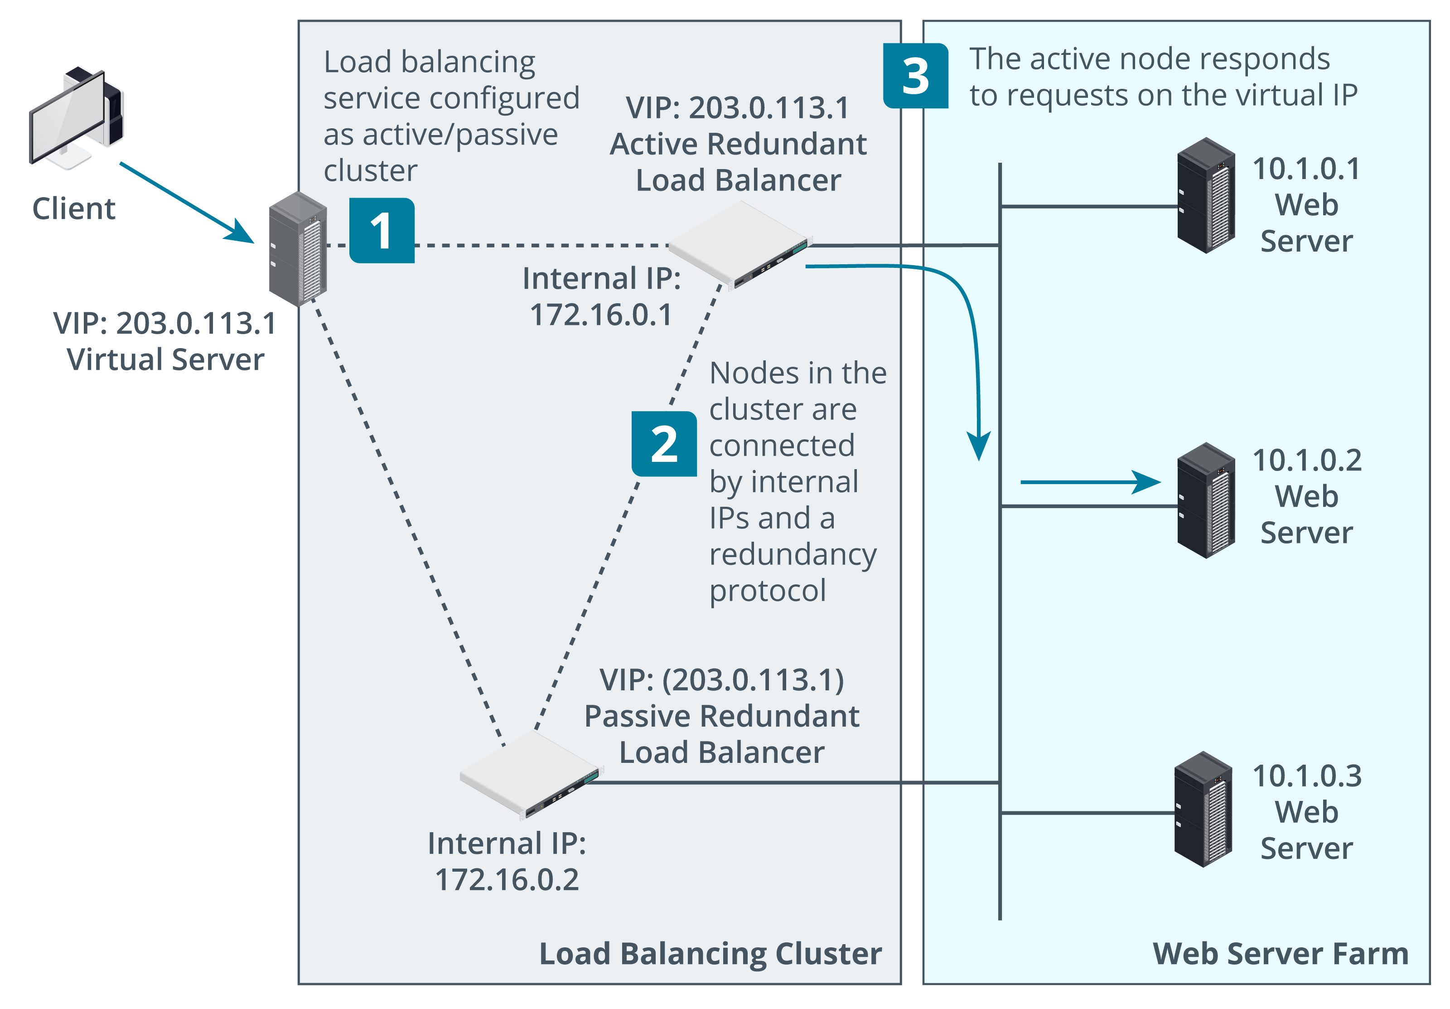
Clustering
Multiple redundant processing nodes that share data with one another
Virtual IP
Active/Passive (A/P)
Active/Active (A/A)
Application Clustering
Topology of clustered load balancing architecture. (Images © 123RF.com.)
Notes:
Where a load balancer distributes client requests between available nodes, clustering enables load balancing "within" a group of servers.

Slide 18
Power Redundancy
Dual Power Supplies
Managed Power Distribution Units (PDUs)
Battery Backups and Uninterruptible Power Supplies (UPSs)
Generators
Notes:
UPS often includes power conditioning features to add additional equipment protection.

Slide 19
Diversity and Defense in Depth
Platform diversity
Multi-Cloud
Vendor Diversity
  Cybersecurity
  Business Resilience
  Innovation
  Competition
  Customization and Flexibility
  Risk Management
  Compliance

Slide 20
Deception Technologies
Honeypots
Honeynets
Honeyfiles
Honeytokens
Fake telemetry
Notes:
While an IDS is primarily designed to detect issues, a honeypot includes forensic level details to help reveal methods used by a malicious user and can help identify zero-day type attacks

Slide 21
Testing Resiliency
Tabletop Exercises
Failover Tests
Simulations
Parallel Processing Tests
Robust Documentation

Slide 22
Redundancy Strategies
Continuity of Operations
Capacity Planning Risks
High Availability
Clustering
Power Redundancy
Diversity and Defense in Depth
Deception Technologies
Testing Resiliency
Notes:
Take some time at the end of each topic to answer questions. You can use the review questions for discussion in class or set them for students to complete individually during or after class.

Slide 23
Physical Security
Lesson 7
Topic 7C

Slide 24
Physical Security Controls
Provides the first line of defense against physical access to an organization's critical assets
Protect physical components that store assets, such as
Servers & Equipment
Datacenters
People
Other critical infrastructure
Notes:
Physical security is typically the responsibility of a dedicated department. As cybersecurity professionals, it is important to understand the elements of physical security to help develop appropriate levels of protection for an organization.

Slide 25
Site Layout, Fencing, and Lighting
Physical Security Through Environmental Design
Barricades and Entry/Exit Points
Fencing
Lighting
Bollards
Notes:
Physical sites at risk of a terrorist attack will use barricades such as bollards and security posts to prevent vehicles from speeding toward a building.

Slide 26
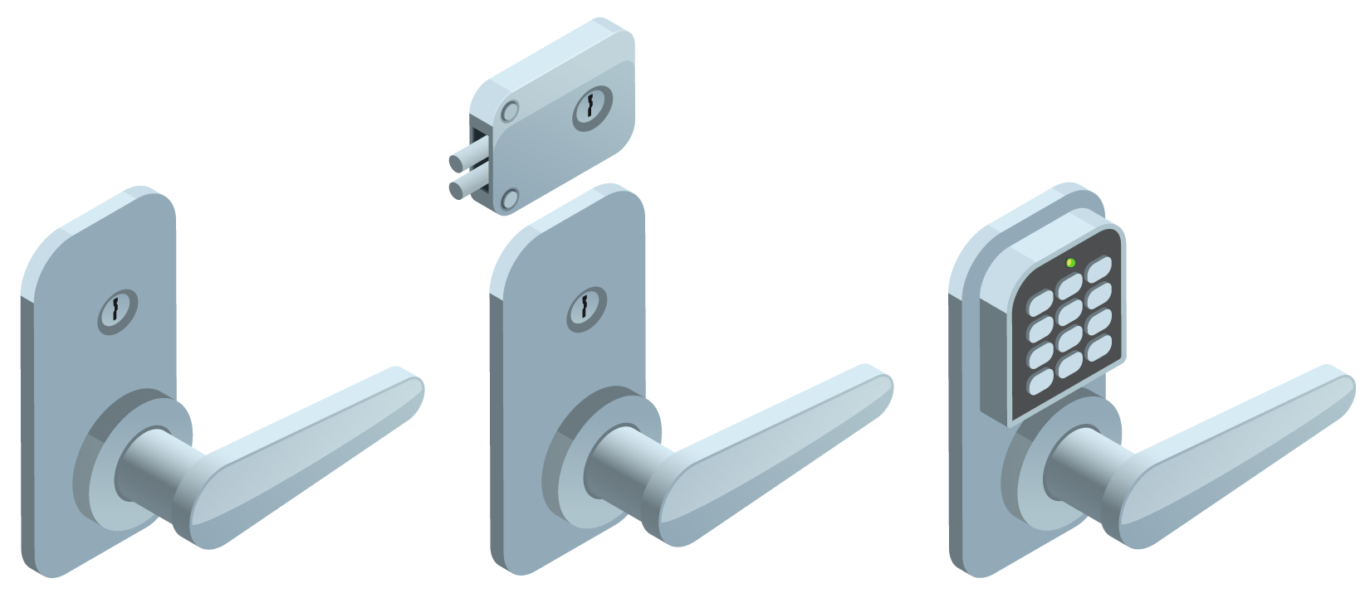
Gateways and Locks
Physical
Electronic
Access Control Vestibule (Mantrap)
Cable Locks
Access Badges
Generic examples of a biometric thumbprint scanner lock and a token-based key card lock. (Images from user macrovector © 123RF.com.)
Notes:
A physical access control system (PACS) is a critical component in managing and maintaining security within a facility. It is a system designed to control who can access specific locations within a building or site. The PACS operates through a combination of hardware and software, including access cards or badges, card readers, access control panels, and a centralized control network.

Slide 27
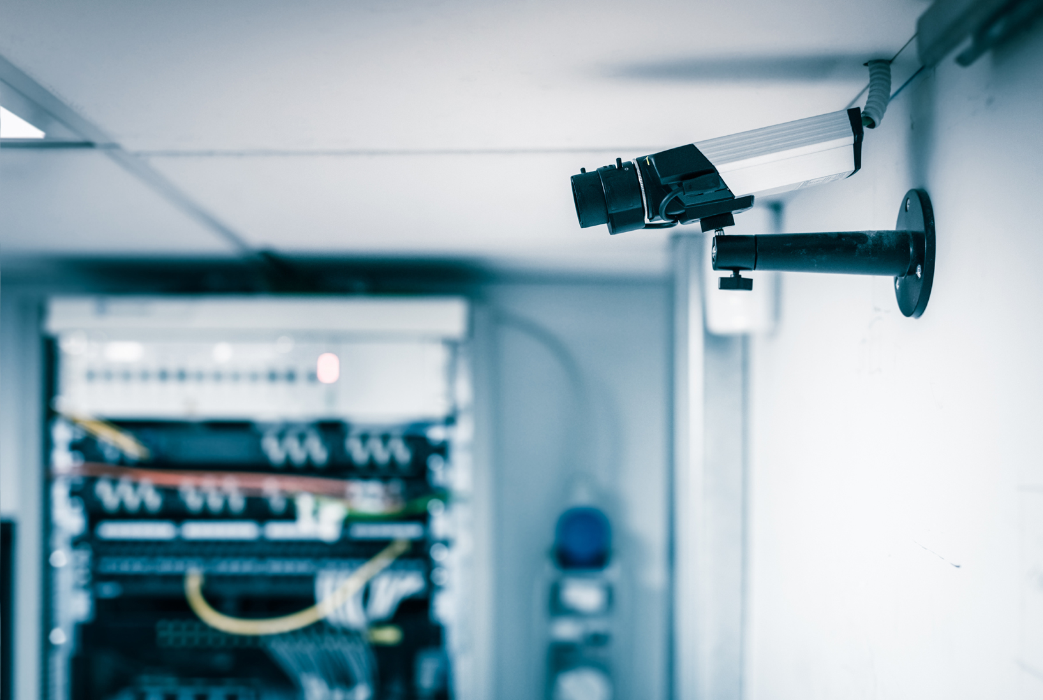
Security Guards and Cameras
Surveillance (CCTV)
Motion Recognition
Object Detection
Drones/UAV
CCTV installed to monitor a server room. (Image by Dario Lo Presti © 123RF.com.)

Slide 28
Alarm Systems and Sensors
Alarms Types
  Circuit
  Motion Detection
  Noise Detection
  Proximity
  Duress
Sensor Types
  Infrared
  Pressure
  Microwave
  Ultrasonic

Slide 29
Physical Security
Physical Security Controls
Site Layout, Fencing, and Lighting
Gateways and Locks
Security Guards and Cameras
Alarm Systems and Sensors
Notes:
Take some time at the end of each topic to answer questions. You can use the review questions for discussion in class or set them for students to complete individually during or after class.

Slide 30
Summary
CompTIA Security+ Exam SY0-701
Lesson 7

